Slide 1
COVID-19
Awareness, Communication & Hygiene

Slide 2
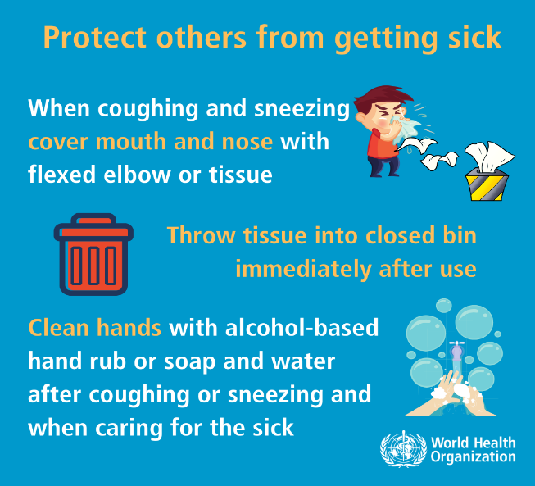
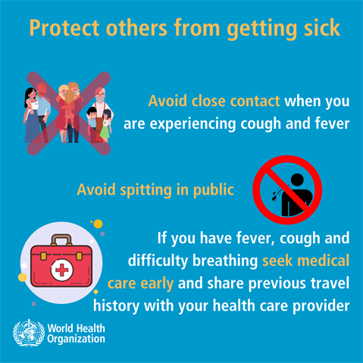
COVID-19
You are likely to have seen the ongoing media coverage of the recent outbreak of COVID-19, which originated in Hubei province in China. More recently, cases have been confirmed in various locations across the world, including the United Kingdom.
COVID-19 is a new illness that can affect your lungs and airways. It's caused by a virus called coronavirus.
COVID-19 can cause more severe symptoms in people with weakened immune systems, older people, and those with long-term conditions like diabetes, cancer and chronic lung disease.
Symptoms
Cough
High temperature
Shortness of breath
*These symptoms do not necessarily mean you have COVID-19
If you feel you are suffering from symptoms that could be COVID-19, please first contact your local health advisory service.
In the UK, the quickest access to advice is by calling the NHS advice line on 111.
Additionally, notify your work manager.
Do
Wash your hands with soap and water often – do this for at least 20 seconds
Always wash your hands when you get home or into work
Use hand sanitiser gel if soap and water are not available
Cover your mouth and nose with a tissue or your sleeve (not your hands) when you cough or sneeze
Put used tissues in the bin straight away and wash your hands afterwards
Try to avoid close contact with people who are unwell
Don’t
Do not touch your eyes, nose or mouth if your hands are not clean

Slide 3
COVID-19
Useful links:
https://www.nhs.uk/conditions/coronavirus-covid-19/
https://www.gov.uk/guidance/coronavirus-covid-19-information-for-the-public
Additional internal information for Mace staff:
https://info.macegroup.com/centralsupport/hs/coronavirusupdates.aspx

